Slide 1
Finite Automata

Slide 2
Finite automata are used to recognize patterns.
It takes the string of symbol as input and changes its state accordingly. When the desired symbol is found, then the transition occurs.

Slide 3
At the time of transition, the automata can either move to the next state or stay in the same state.
Finite automata have two states, Accept state or Reject state. When the input string is processed successfully, and the automata reached its final state, then it will accept.

Slide 4
Formal Definition of FA
A finite automaton is a collection of 5-tuple (Q, ∑, δ, q0, F), where:

Slide 5
Q: finite set of states
∑: finite set of the input symbol
q0: initial state
F: final state
δ: Transition function

Slide 6
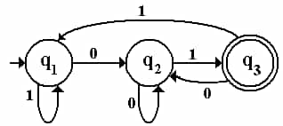

Slide 7
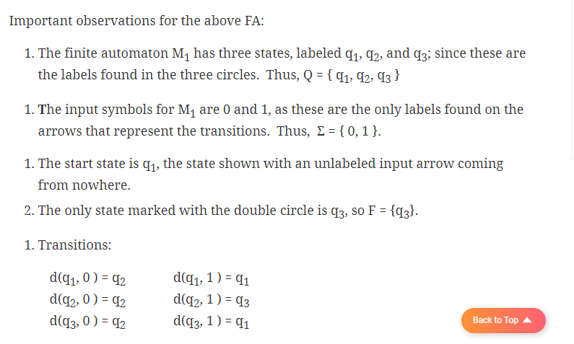

Slide 8
Types of Automata:
There are two types of finite automata:
DFA(deterministic finite automata)
NFA(non-deterministic finite automata)

Slide 9
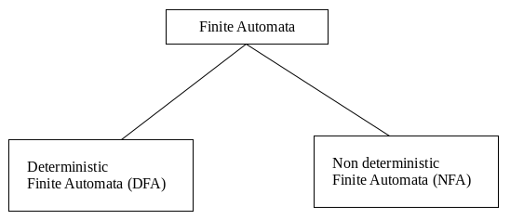

Slide 10
DFA (Deterministic finite automata)
DFA refers to deterministic finite automata. Deterministic refers to the uniqueness of the computation. The finite automata are called deterministic finite automata if the machine is read an input string one symbol at a time.

Slide 11
In the following diagram, we can see that from state q0 for input a, there is only one path which is going to q1. Similarly, from q0, there is only one path for input b going to q2.

Slide 12
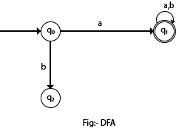

Slide 13
Formal Definition of DFA
A DFA is a collection of 5-tuples same as we described in the definition of FA

Slide 14
Q: finite set of states
∑: finite set of the input symbol
q0: initial state
F: final state
δ: Transition function

Slide 15
Transition function can be defined as:
δ: Q x ∑→Q

Slide 16
Examples
Q = {q0, q1, q2}
∑ = {0, 1}
q0 = {q0}
F = {q2}

Slide 17

Solution:
Transition Diagram:

Slide 18
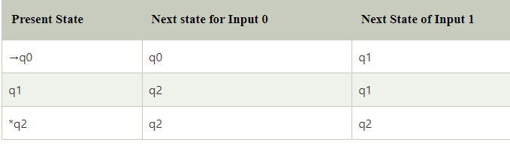
Transition Table:

Slide 19
Example 3
DFA with ∑ = {0, 1} accepts all ending with 0.

Slide 20
In the above diagram, we can see that on given 0 as input to DFA in state q0, the DFA changes state to q1. It can accept any string which ends with 0 like 00, 10, 110, 100....etc. It can't accept any string which ends with 1, because it will never go to the final state q1 on 1 input, so the string ending with 1, will not be accepted or will be rejected.

Slide 21


Slide 22
NFA (Non-Deterministic finite automata)
NFA stands for non-deterministic finite automata. It is easy to construct an NFA than DFA for a given regular language.
The finite automata are called NFA when there exist many paths for specific input from the current state to the next state.

Slide 23
Every NFA is not DFA, but each NFA can be translated into DFA.

Slide 24
In the following image, we can see that from state q0 for input a, there are two next states q1 and q2, similarly, from q0 for input b, the next states are q0 and q1. Thus it is not fixed or determined that with a particular input where to go next. Hence this FA is called non-deterministic finite automata.

Slide 25
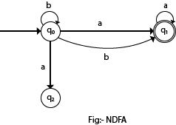

Slide 26
Formal definition of NFA:
δ: Q x ∑ →2^{Q}
Q: finite set of states
∑: finite set of the input symbol
q0: initial state
F: final state
δ: Transition function

Slide 27
Example 1:
Q = {q0, q1, q2}
∑ = {0, 1}
q0 = {q0}
F = {q2}

Slide 28
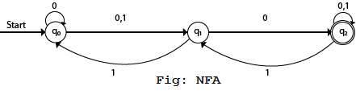
Solution:
Transition diagram:

Slide 29
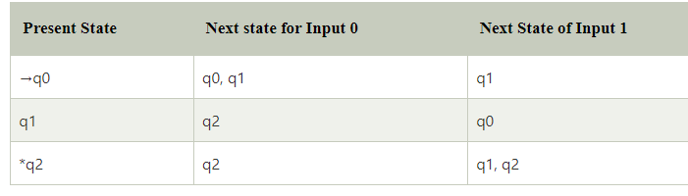
Transition Table:

Slide 30
Example 1:
Design a NFA for the transition table as given below

Slide 31
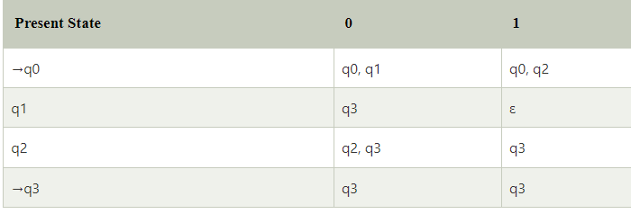

Slide 32
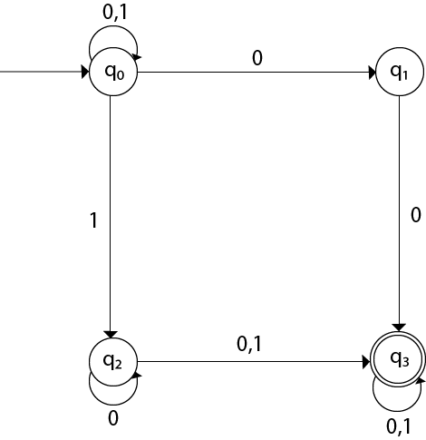
Solution:

Slide 33
Transition Table
The transition table is basically a tabular representation of the transition function.

Slide 34
A transition table is represented by the following things:
Columns correspond to input symbols.
Rows correspond to states.
Entries correspond to the next state.
The start state is denoted by an arrow with no source.
The accept state is denoted by a star.

Slide 35
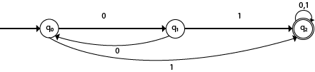

Slide 36
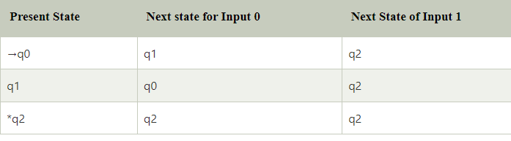

Slide 37

Example 2:

Slide 38
Solution:
Transition table of given NFA is as follows:

Slide 39
